Slide 1
BRASS Scenario 4
Relay Scenario
From a flight test that occurred in July 1989

Slide 2
Scenario #4 – Brief Description
A relay is using one aircraft to transmit data from one aircraft to another such that the aircraft of interest need not be accessible directly by ground antenna.
The scenario involves a single radio on the ground network, a single radio on a relay network (TA1), and a single radio on TA2 network as shown in the next slide. During the scenario the TA1 relay is needed for another priority mission so we need to adapt by using available assets to preserve the transmission of data in the case TA2 is outside the transmission range.
In this scenario the transmission schedule is fixed for all radios in the scenario.
How can the transmission be preserved when the aircraft is outside the transmission range of the ground radio without losing end-to-end communication?

Slide 3
Scenario Description
TA1 is configured to be the relay when TA2 is out of range of the ground radio as shown here.
Test Aircraft
Relay Aircraft
Other nearby resources

Slide 4



Scenario Description
During the test, TA1 is re-assigned to another mission. How do we need to adapt to this change?
One adaptation:
An operator on the MCR decides to re-allocate an available omni radio on a airship they used for other previous tests to be the new relay radio to preserve the transmission between TA2 and the ground. These are the steps the operator needs to follow to adapt:
Reconfigure Ground Station 1 so it stops transmitting to TA1
Configure Airship “Ground” to transmit to TA2 when outside the transmission range
We are shifting role from Ground Station 1 to Airship “Ground” Station
Another Adaptation is to land:
They can choose what is most valuable to them
TA2
TA1
Airship
Ground
Station
Ground Station
(GR1)
Mission Control Room
Ground Station Used by
Another Test

Slide 5
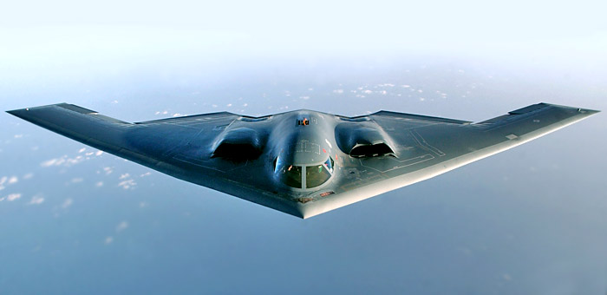
Test Article
Aircraft: B-2 Bomber
U.S. Stealth Bomber Makes Test Flight Without Mishap
By RICHARD W. STEVENSON, Special to The New York Times
Published: July 18, 1989
EDWARDS AIR FORCE BASE, Calif., July 17— After a decade of development and $22 billion in expenditures, the B-2 Stealth bomber got off the ground for the first time today, making a two-hour test flight over the California desert. http://www.nytimes.com/1989/07/18/us/us-stealth-bomber-makes-test-flight-without-mishap.html

Slide 6
Range Infrastructure
Range Network: Typical large military range e.g. Edwards Air Force Flight Test Center
Equipment Used:
Ground Station Tracking Antenna and related network infrastructure
MCR processing live data
Equipment Available:
Airship “Ground” Station
Others are all in use

Slide 7
Flight Test Operation Flow

Slide 8
Static Scheduling
Before the start of the mission the radios are individually configured for the described test mission with the following QoS (Quality of Service)
Voice: 50 Kb/s
Safety: 100 Kb/s
Bulk: 1000 Kb/s

Slide 9
Transmission Schedule
GR1-TA1: 0 ms – 11.5 ms
TA1-TA2: 12.5 ms – 24 ms
TA2-TA1: 25 ms – 36.5 ms
TA1-GR1: 37.5 ms – 49 ms
GR1-TA1: 50 ms – 61.5 ms
TA1-TA2: 62.5 ms – 74 ms
TA2-TA1: 75 ms – 86.5 ms
TA1-GR1: 89.5 ms – 99 ms
Epoch Size: 100 ms
Symmetric schedule
Requirement: 50ms latency
Epoch size: 100 ms
100 ms/ 50 ms = 2 transmission per link (at a minimum)
50 ms – 4 ms (4 Guard Band with 1 ms each) = 46 ms
We have 46 ms we can use for transmission

Slide 10
Associated Constraints
Physical limit on amount of bandwidth that can be achieved
Schedule must be valid

Slide 11
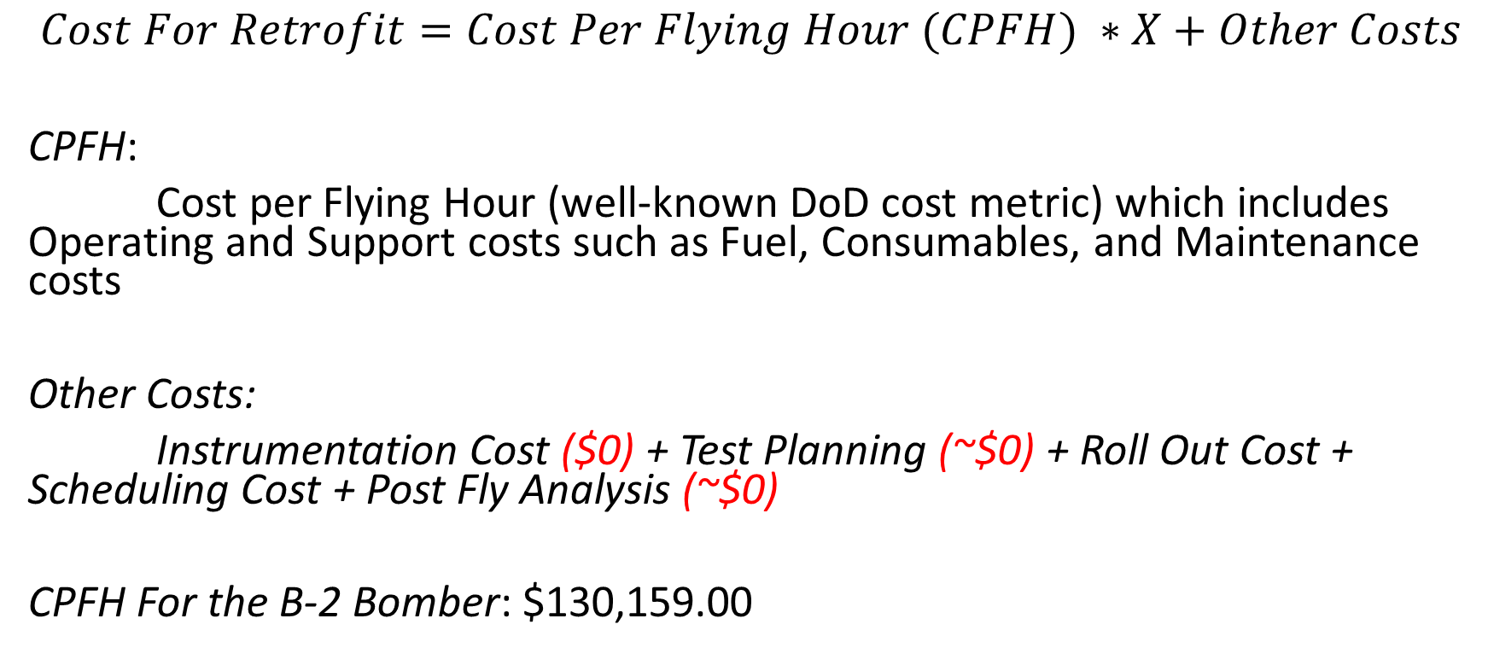
Cost Metrics
$$Cost For Retrofit=Cost Per Flying Hour (CPFH) ∗X+Other Costs$$
CPFH:
Cost per Flying Hour (well-known DoD cost metric) which includes Operating and Support costs such as Fuel, Consumables, and Maintenance costs
Other Costs:
Instrumentation Cost ($0) + Test Planning (~$0) + Roll Out Cost + Scheduling Cost + Post Fly Analysis (~$0)
CPFH For the B-2 Bomber: $130,159.00
Assumptions:
(1) Aircraft was already instrumented
(2) We approximate the Rollout Costs and Scheduling Costs to be ~ the cost of an hour cost

Slide 12
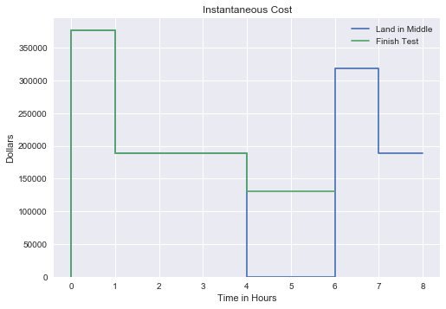
Cost Metric Instantaneous Cost
At the start of the test, both TAs cost applies to the test
When TA1 gets taken away, the cost no longer applies
If landing in the middle is chosen, no costs are incurred until takeoff, when both TAs are again costing money

Slide 13
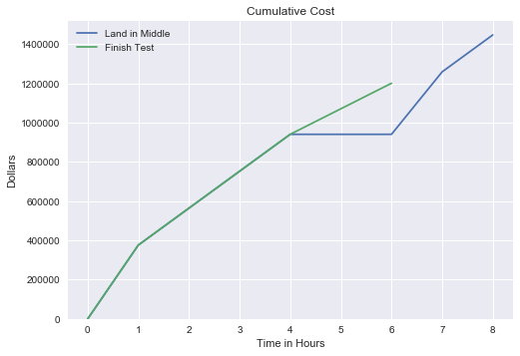
Cost Metric Cumulative Cost

Slide 14
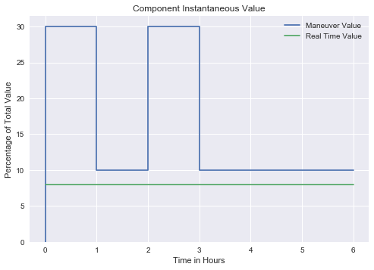
Program Value Function Component Instantaneous Value
Maneuvers are worth their percentage value when performed
Real time data is worth a constant value

Slide 15
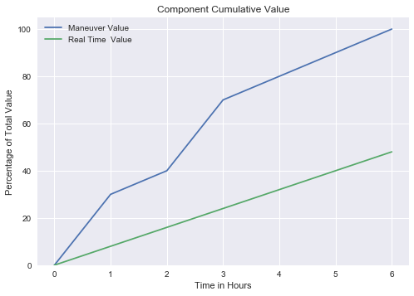
Program Value Function Component Cumulative Value

Slide 16
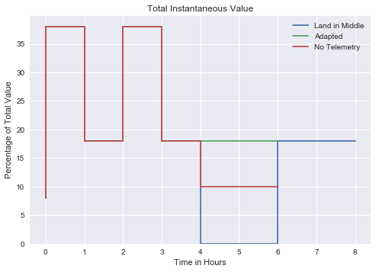
Program Value Function Total Instantaneous Value
Land in middle delays all value until TA1 becomes available again
Adapted tactic redirects telemetry to the airship, so all value is gained
No telemetry elects to drop all real-time telemetry

Slide 17
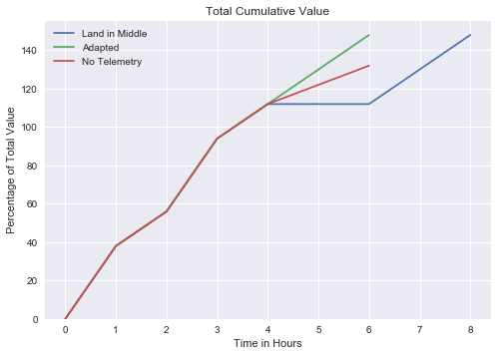
Program Value Function Total Cumulative Value

Slide 18
Risk Metric
Measures the future uncertainties in achieving the test mission within the defined cost and schedule constraints
Risk Probability that a particular event will occur
Level | Value | Criteria
5 | Near certainty | Everything points to this becoming a problem
4 | Very likely | High chance of this becoming a problem
3 | Likely (50/50) | There is an even chance this may turn into a problem once in a while
2 | Unlikely | Risk like this may turn into a problem once in a while
1 | Improbable | Not much chance this will become a problem

Slide 19
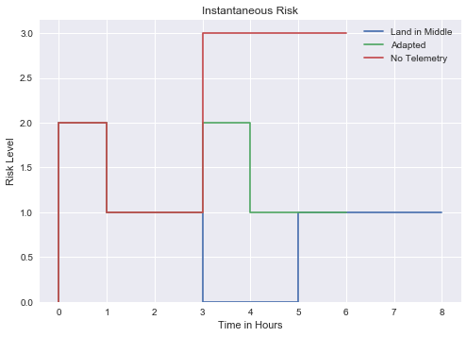
Risk Metric Instantaneous Risk
Land in middle introduces no extra risk
Adapted tactic introduces a small reconfigure risk for setting up the new schedule
No telemetry, without real-time flight data, is riskier as safety of flight data cannot be monitored outside of the test article

Slide 20
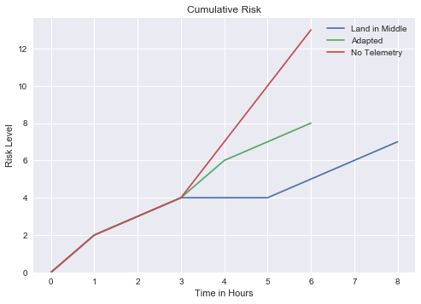
Risk Metric Cumulative Risk

Slide 21
Classic Solution
Return To Base and finish when TA1 is available
No MDL changes needed for this solution

Slide 22
Suggested Solution
Configure the Airship “Ground” Radio to transmit to TA2
Reconfigure Ground Radio 1 to STOP transmitting to TA1
We don’t want to waste bandwidth

Slide 23
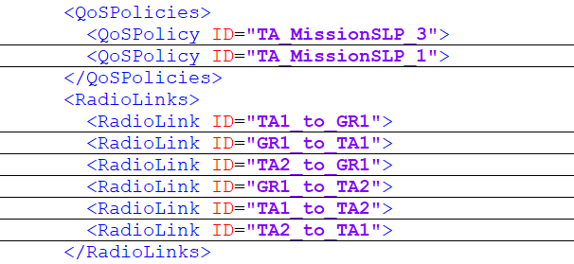
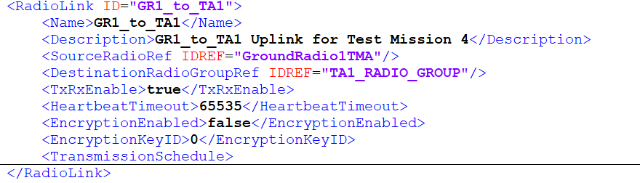
MDL Configuration – Before Adaptation
Radio Links are defined in the <RadioLinks> element in MDL
Enabled RF Transmission Links

Slide 24
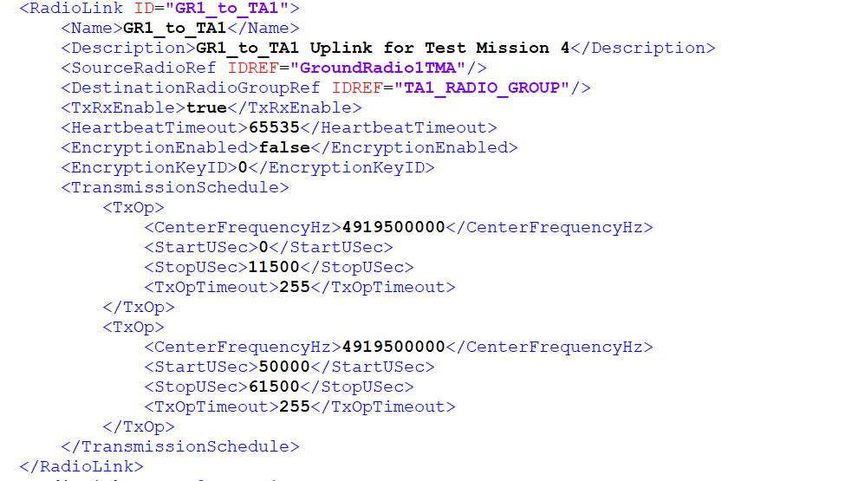
Transmission Schedule GR1 to TA1 RF Uplink
GR1-TA1: 0 ms – 11.5 ms
TA1-TA2: 12.5 ms – 24 ms
TA2-TA1: 25 ms – 36.5 ms
TA1-GR1: 37.5 ms – 49 ms
GR1-TA1: 50 ms – 61.5 ms
TA1-TA2: 62.5 ms – 74 ms
TA2-TA1: 75 ms – 86.5 ms
TA1-GR1: 89.5 ms – 99 ms

Slide 25
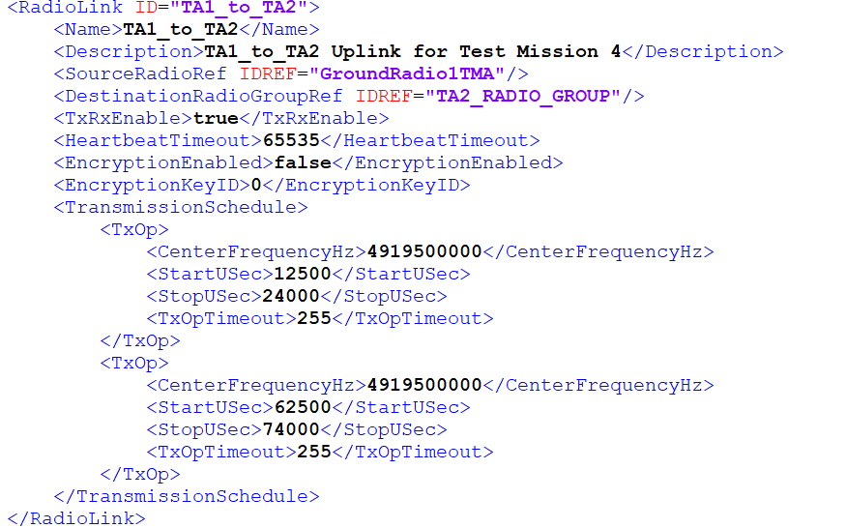
Transmission Schedule TA1 to TA2 RF Uplink
GR1-TA1: 0 ms – 11.5 ms
TA1-TA2: 12.5 ms – 24 ms
TA2-TA1: 25 ms – 36.5 ms
TA1-GR1: 37.5 ms – 49 ms
GR1-TA1: 50 ms – 61.5 ms
TA1-TA2: 62.5 ms – 74 ms
TA2-TA1: 75 ms – 86.5 ms
TA1-GR1: 89.5 ms – 99 ms

Slide 26
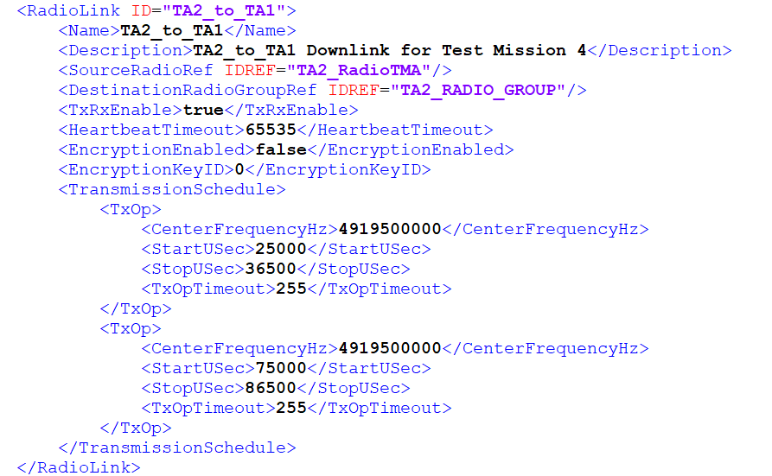
Transmission Schedule TA2 to TA1 RF Downlink
GR1-TA1: 0 ms – 11.5 ms
TA1-TA2: 12.5 ms – 24 ms
TA2-TA1: 25 ms – 36.5 ms
TA1-GR1: 37.5 ms – 49 ms
GR1-TA1: 50 ms – 61.5 ms
TA1-TA2: 62.5 ms – 74 ms
TA2-TA1: 75 ms – 86.5 ms
TA1-GR1: 89.5 ms – 99 ms

Slide 27
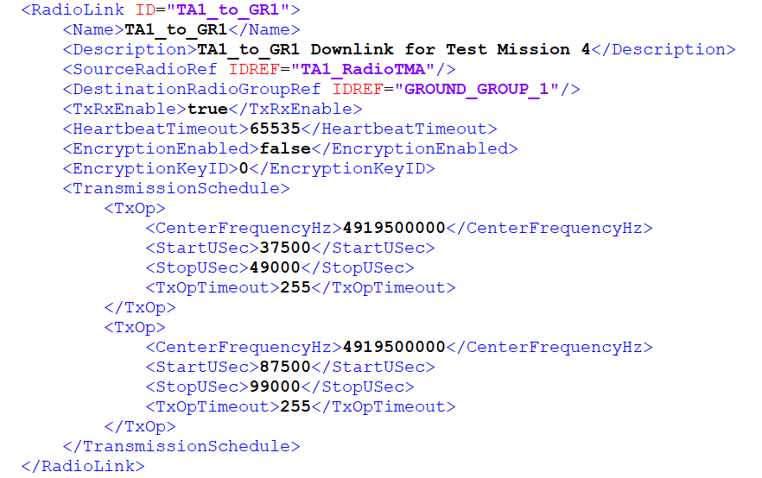
Transmission Schedule TA1 to GR1 RF Downlink
GR1-TA1: 0 ms – 11.5 ms
TA1-TA2: 12.5 ms – 24 ms
TA2-TA1: 25 ms – 36.5 ms
TA1-GR1: 37.5 ms – 49 ms
GR1-TA1: 50 ms – 61.5 ms
TA1-TA2: 62.5 ms – 74 ms
TA2-TA1: 75 ms – 86.5 ms
TA1-GR1: 89.5 ms – 99 ms

Slide 28
MDL Configuration – After Adaptation
Configure the Airship “Ground” Radio to transmit to TA2
Create RF links between GR1-BR-TA2
Reconfigure GR1 to STOP transmitting to TA1
Deactivate RF links between GR1-TA1-TA2
→ Airship “Ground” Radio is the Relay replacement

Slide 29
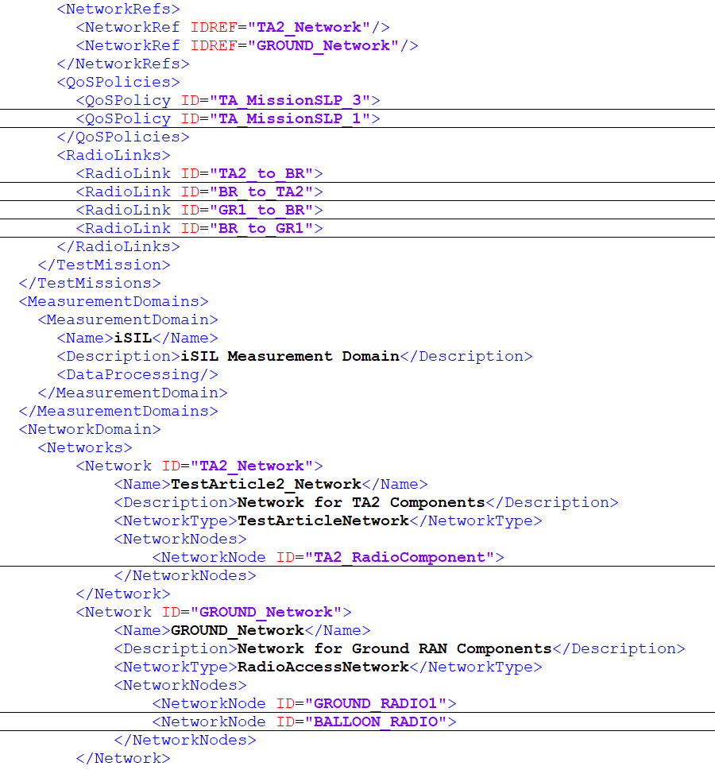
MDL Configuration – After Adaptation

